Slide 1


Recovering Complex Conductivity from Frequency and Time Domain Geophysical Surveys
13 December 2013
Seogi Kang*, Dave Marchant, Doug Oldenburg

Slide 2
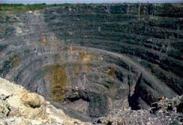
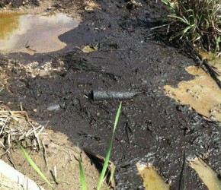
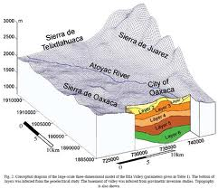
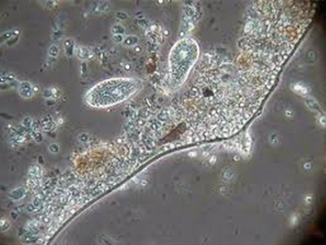
What is this phenomenon?
Exploration of massive sulphide deposits
(Mining application)
Hydrocarbon contaminant concentration
Induced Polarization (IP) effect
Lithology and hydrological properties
Microbial activity

Slide 3
Outline
What is the IP effect?
Objectives
Building up conceptual model
Identification of IP responses
Conclusions and the path ahead

Slide 4
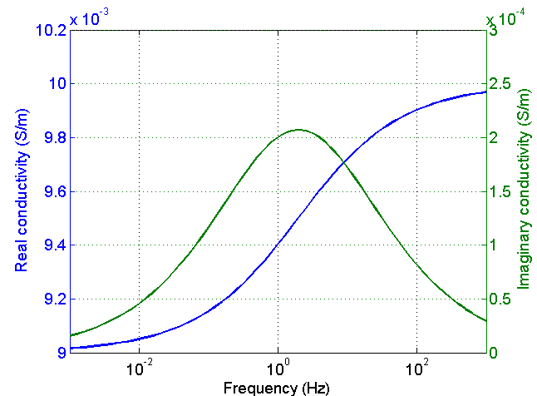
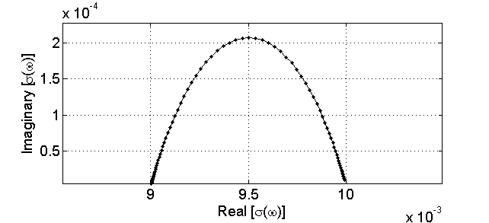
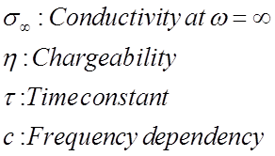
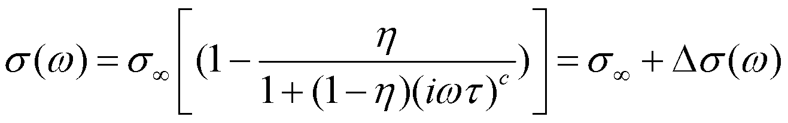
Conductivity is frequency dependent
Cole-Cole model
ω=0
ω=∞

Slide 5
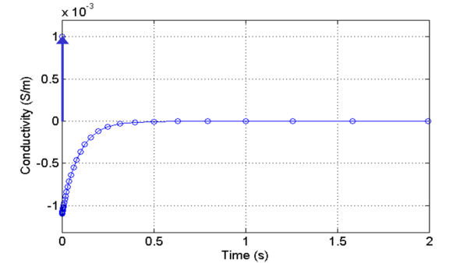
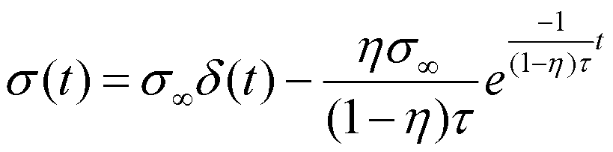
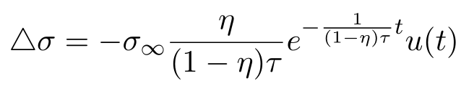
Conductivity is time dependent
Assuming Cole-Cole model for c = 1
σ∞δ (t)
σ (t) = σ∞δ (t) +∆σ (t)
∆σ(t)

Slide 6
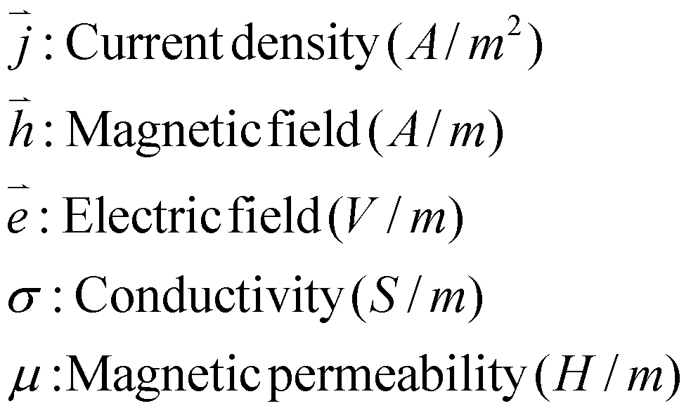
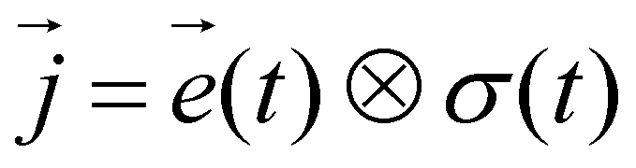
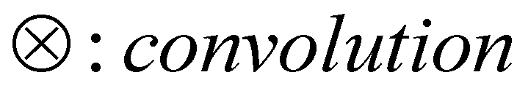
Background
Maxwell’s equations in time
σ (ω)
Ohm’s law in frequency domain
Ohm’s law in time domain
σ (t)
Notes:
From abstract and elsewhere

Slide 7
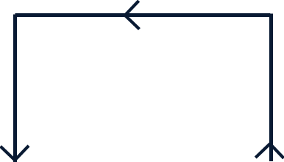
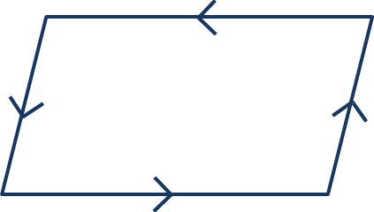
Controlled-source EM
Transmitters
“Frequency” and “time” domain systems
Grounded source
Loop source
Airborne EM
Loop EM …
DCIP
CSAMT …
Galvanic
Inductive

Slide 8
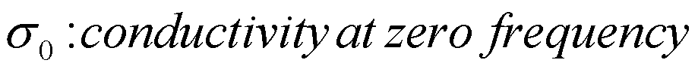
Forward modelling: time domain
Auxiliary equations approach
Marchant et al. (2012)
Cole-Cole model, c = 1
A tool to compute Airborne TEM-IP responses
Notes:
Maybe a slide with a few Frequency domain conductivities and the representative sigma(t)
Equations written in convolution format

Slide 9
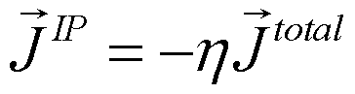
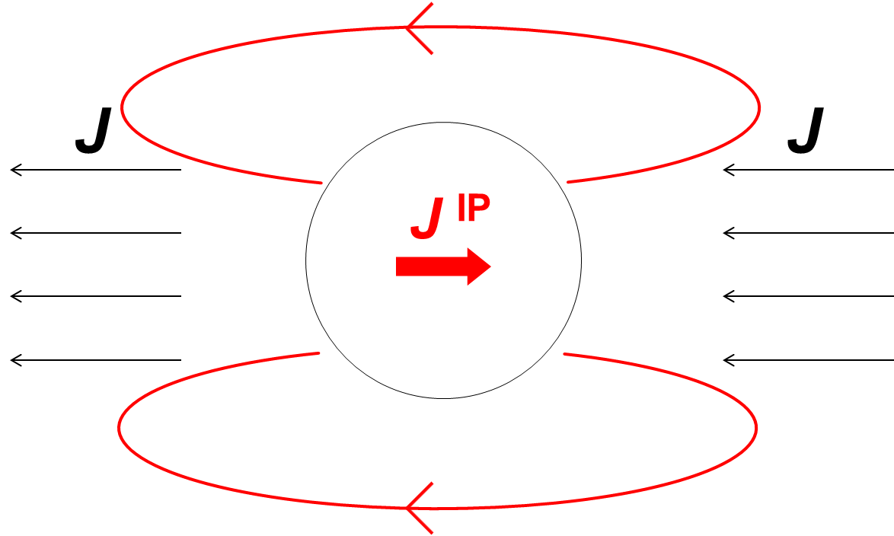
Conceptual model
Seigel (1959)
J
J
J ^{IP}
J^{IP} has opposite direction to J^{total}
Magnitude of J^{IP} is proportional to chargeability (η)
Notes:
From abstract and elsewhere

Slide 10

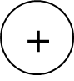
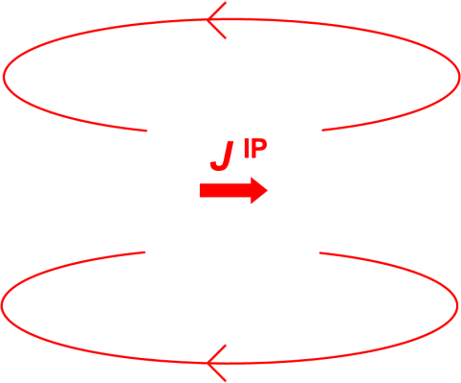
DC-IP case: Guess
-
J ^{total}
J ^{IP}
+
Notes:
It seems that something wrong need to ask dikun?

Slide 11
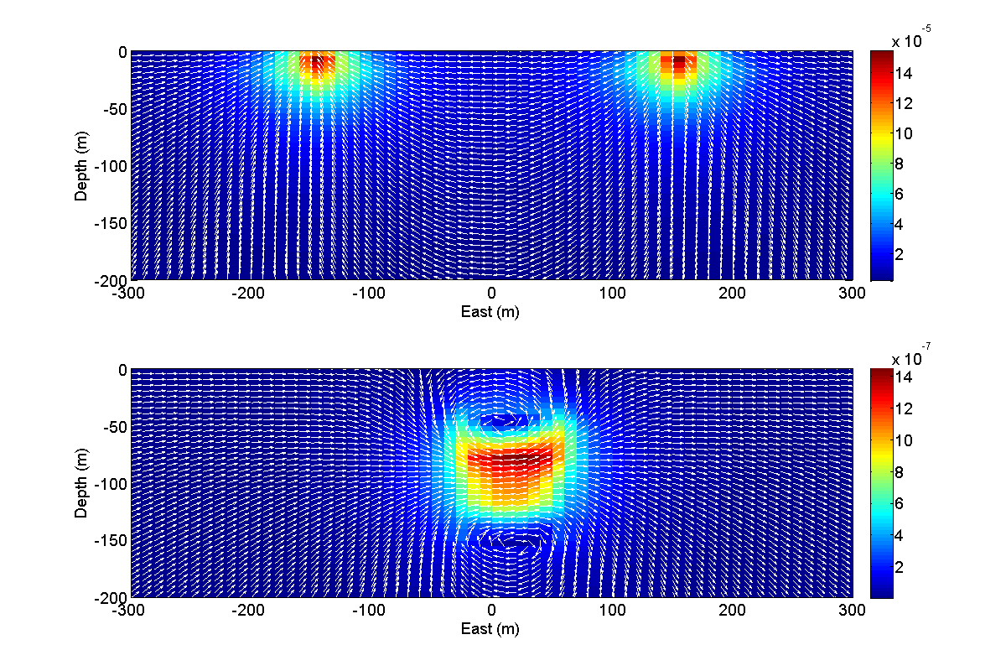
DC-IP case
DC-IP case: Numerical experiment
DC current density section
J ^{total}
Notes:
It seems that something wrong need to ask dikun?

Slide 12
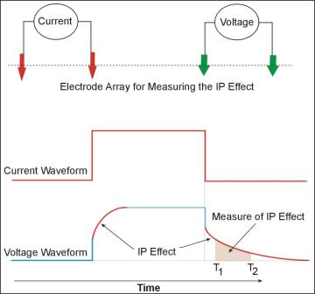
DC-IP case
DC-IP case: Numerical experiment
DC current density section
Overvoltage effect
J ^{total}
V
IP current density section
Notes:
It seems that something wrong need to ask dikun?

Slide 13
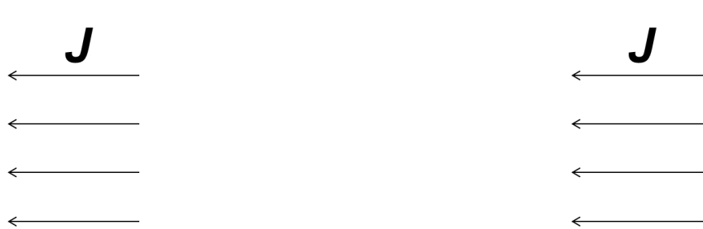
DC-IP inversion
Current
Voltage
I
V
Restoring distribution of IP parameters from ATEM-IP responses has not been fully accomplished.
Overvoltage effect
Oldenburg and Li (1994)
Yuval and Oldenburg (1997)
Routh and Oldenburg (2001)
Notes:
Maybe a slide with a few Frequency domain conductivities and the representative sigma(t)
Equations written in convolution format

Slide 14
We want to …
Recover distribution IP parameters from Airborne TEM-IP responses
Is conceptual model of IP effects in DC valid in ATEM?
How to identify IP responses?

Slide 15

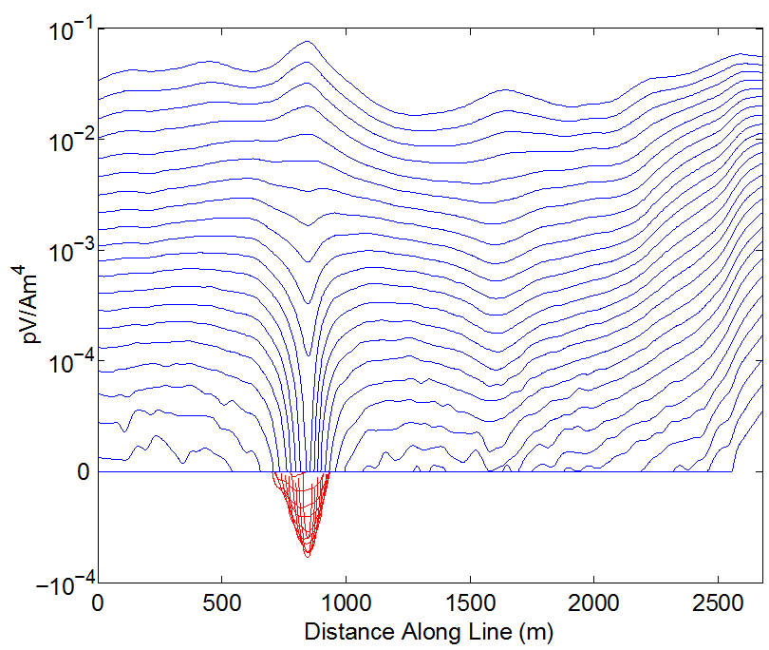
Different experiments
Current
Voltage
J ^{pol}
I
V
Negative transients (dB/dt)
in coincident loop system
J
J

Slide 16
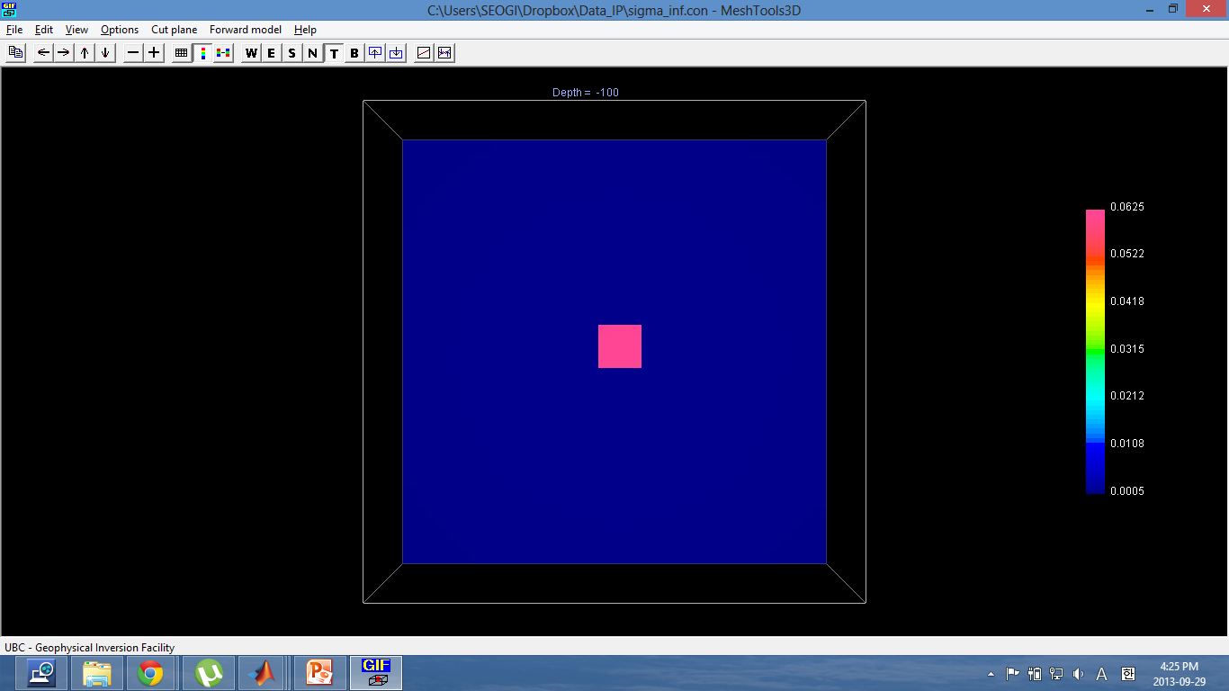
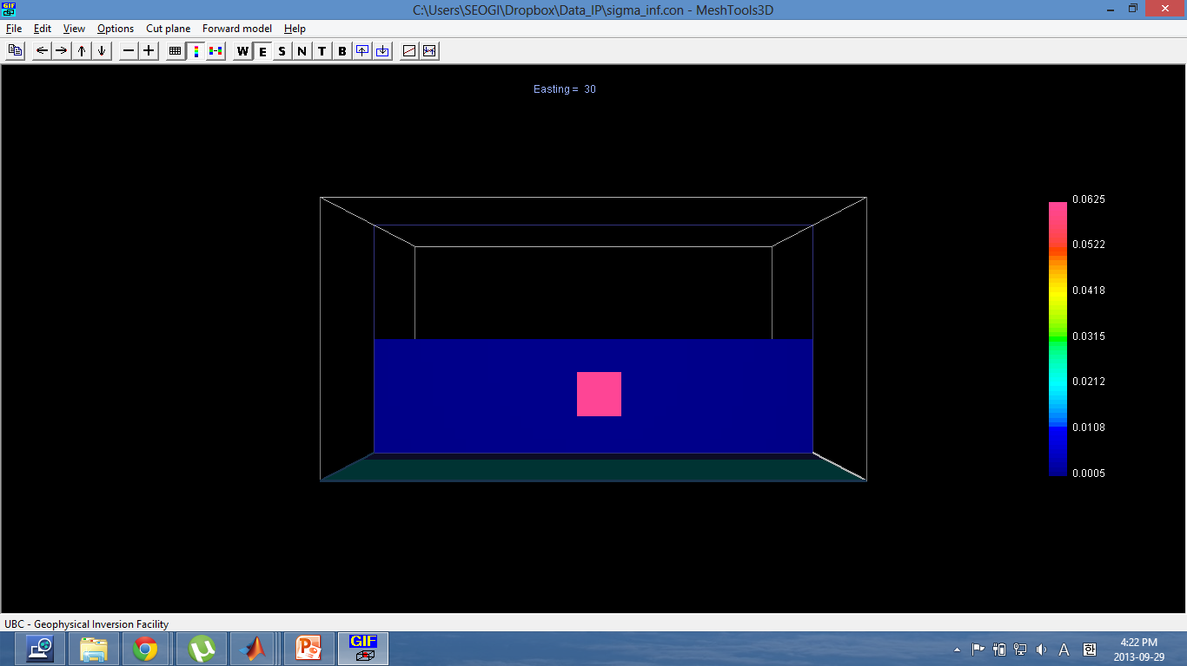
Synthetic example
Conductivity model
800 m
Discretization
- 20 m core cells
- 69 x 69 x 50 cells
Background
σ_{half} = 5e-4 S/m
Target
- σ∞ = 5e-4 S/m
- η = 0.2
- τ = 0.01
- 80m x 80m x 80m
- 60m below surface
North-South
800 m
East-West
-60
Depth (m)
-160
-400
-30
50
400
East-West (m)

Slide 17
Synthetic example
IP model
800 m
Discretization
- 20 m core cells
- 69 x 69 x 50 cells
Background
σ_{half} = 5e-4 S/m
Target
- σ∞ = 5e-4 S/m
- η = 0.2
- τ = 0.01
- 80m x 80m x 80m
- 60m below surface
North-South
800 m
East-West
-60
Depth (m)
-160
-400
-30
50
400
East-West (m)

Slide 18
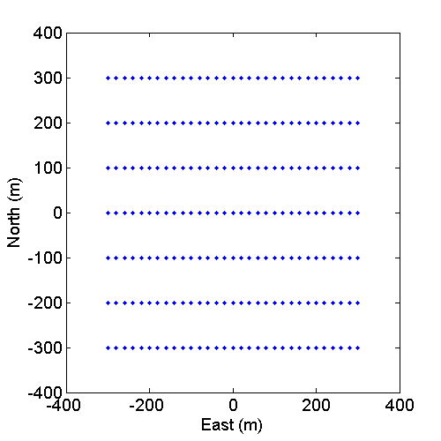
Synthetic example
Geometry
VMD source
- 30m above surface
- Coincident loop
- Step-off waveform
7×31 = 217 Tx-Rx pair
Receivers
- Collocated with Tx
- Measuring db/dt
- 10⁻⁵ – 10⁻¹ seconds

Slide 19
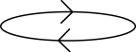


ATEM-IP case: Conceptual model
J ^{IP}
I (current)
z
y
x
J ^{EM}
J ^{IP}
EMIP: with IP effect
EM: without IP effect
J ^{IP}
J^{EMIP} = J^{EM}+J^{IP}
Notes:
It seems that something wrong need to ask dikun?

Slide 20
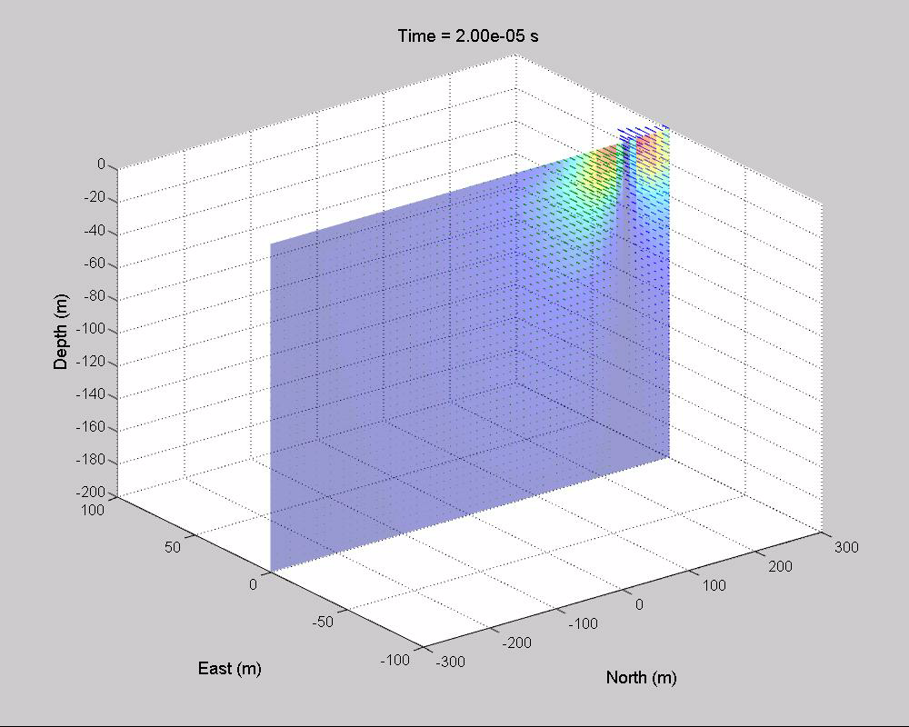
ATEM case without IP effect (EM)
Total current density (J^{total}) section
z
y
x
J ^{EM}
Notes:
It seems that something wrong need to ask dikun?

Slide 21
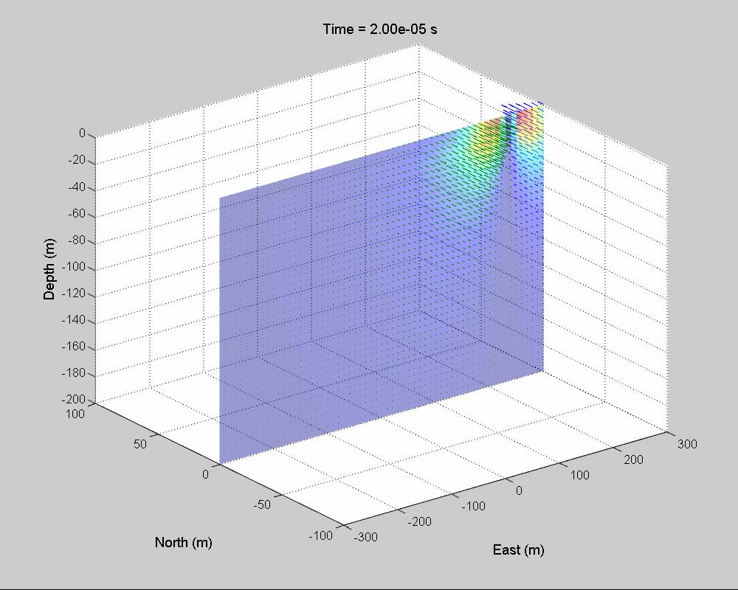
ATEM case with IP effect (EMIP)
Total current density (J^{total}) section
I (current)
z
y
x
J ^{EM}
J ^{IP}
Notes:
It seems that something wrong need to ask dikun?

Slide 22
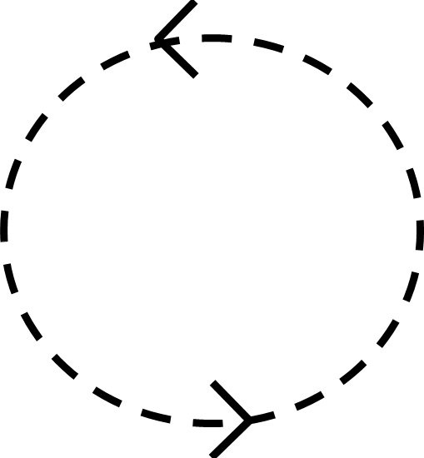
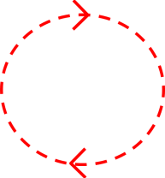
ATEM IP effect
Plan view
North
J^{total} without IP
J^{total} with IP
East
J ^{EM}
J ^{EM}
J ^{IP}
I (current)
I (current)
J^{EMIP} = J^{EM}+J^{IP}
Notes:
It seems that something wrong need to ask dikun?

Slide 23
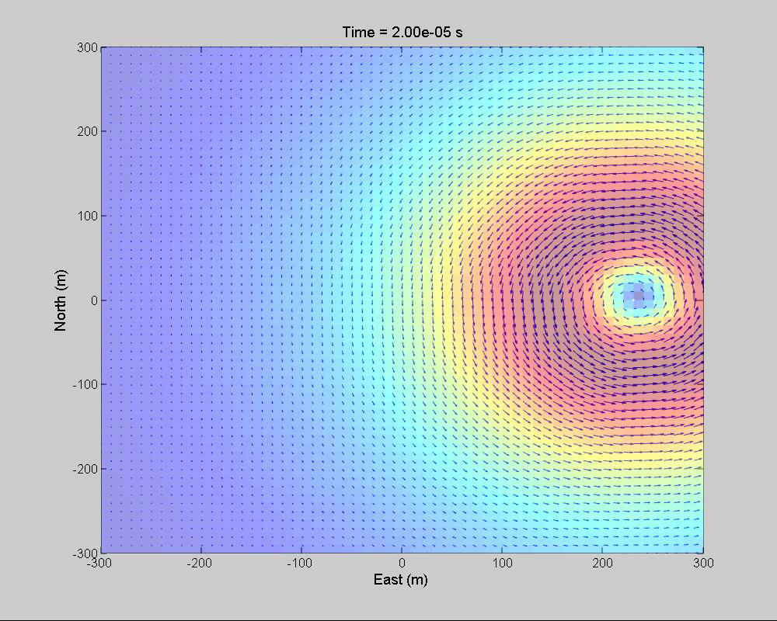

ATEM IP effect
Plan view
North
J^{total} without IP
J^{total} with IP
East
J ^{EM}
J ^{EM}
J ^{IP}
Compatible with conceptual model
More chances to observe IP response in late times
Notes:
It seems that something wrong need to ask dikun?

Slide 24
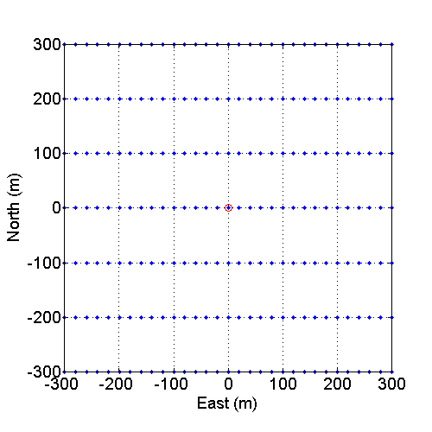
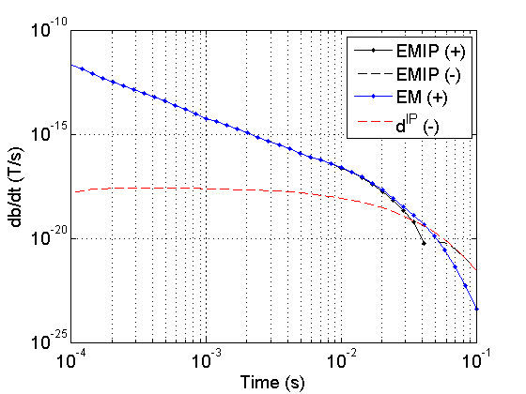
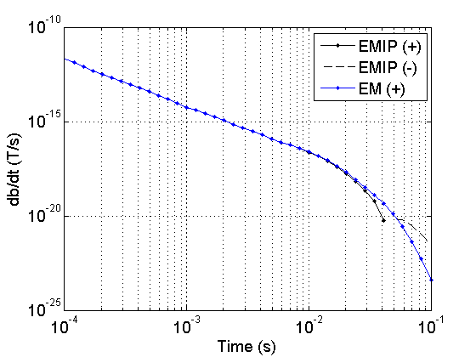
Measured ATEM responses
σ (t) = σ∞δ (t) +∆σ (t)
db/dt response at (0, 0)
ATEM responses
EMIP: with IP effect
EM: without IP effect
EM decoupling process
EMIP = F[σ∞+∆σ(t)]
EM = F [σ∞]
d^{IP} = F [σ∞+∆σ(t)]- F [σ∞]
d^{IP}
F[σ∞δ (t) +∆σ (t)]
F[σ∞δ (t)]
Notes:
It seems that something wrong need to ask dikun?

Slide 25
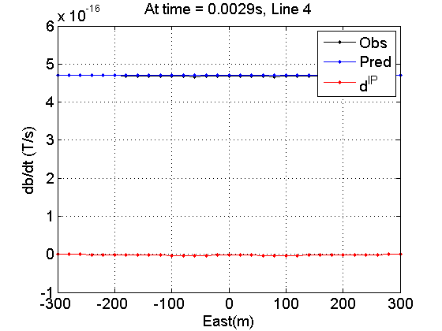
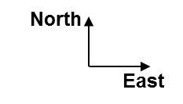
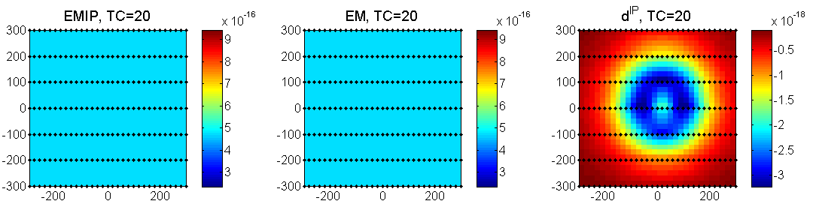
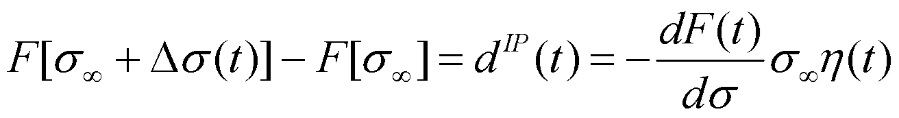
Synthetic Airborne EM data
db/dt data at time = 0.0029s
db/dt (T/s)
db/dt (T/s)
db/dt (T/s)
Notes:
It seems that something wrong need to ask dikun?

Slide 26
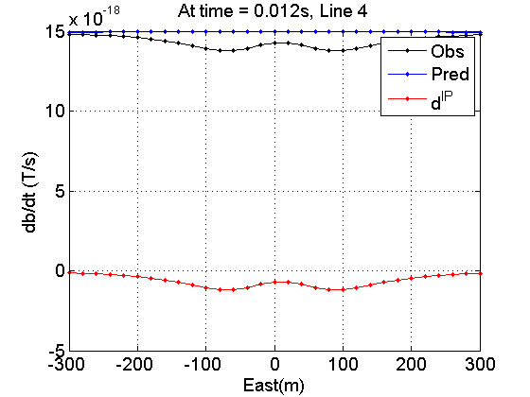

Synthetic Airborne EM data
db/dt data at time = 0.012s
db/dt (T/s)
db/dt (T/s)
db/dt (T/s)
Notes:
It seems that something wrong need to ask dikun?

Slide 27
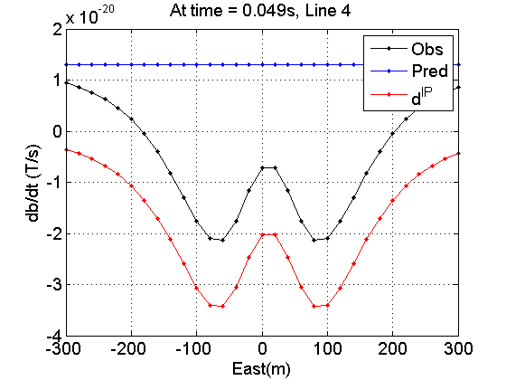
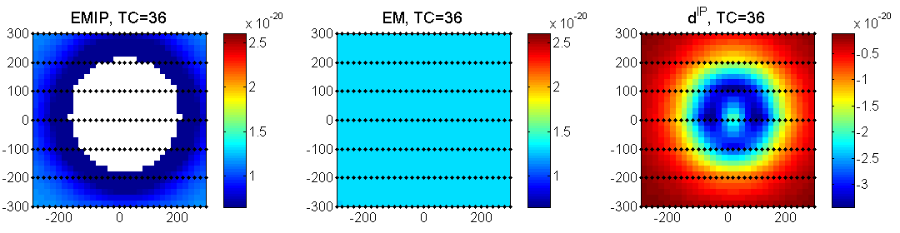
Synthetic Airborne EM data
db/dt data at time = 0.049s
d^{IP}
F[σ∞δ (t) +∆σ (t)]
F[σ∞δ (t)]
Accurate estimation of background model (σ∞) is crucial
We can recover a reasonable σ∞ model by inverting early time channels, effectively (Dikun et al., 2012)
db/dt (T/s)
db/dt (T/s)
db/dt (T/s)
Notes:
It seems that something wrong need to ask dikun?

Slide 28
Summary and path forward
Building up conceptual model for Airborne TEM-IP responses (J^{IP} = -ηJ^{total})
Identifying IP responses in Airborne TEM data
- EM decoupling: d^{IP} = F [σ∞δ(t)+∆σ(t)]- F [σ∞]
Estimating σ∞ , 3D background conductivity (challenge)
Summary

Slide 29
Summary and path forward
Extending linearized inversion of DC-IP to Airborne TEM-IP inversion and validating
Recovering IP parameter distribution from Airborne TEM
Why not other types of EM geophysics?
Land CSEM (Loop or Grounded)
DC and MMR
Marine EM
Passive EM (MT, ZTEM)
Time domain or frequency domain …
Path forward

Slide 30
Thank you ☺

